Slide 1
Introduction to Computer Simulation of Physical Systems (Lecture 9)
PHYS 3061

Slide 2
Random Walk Solution of Laplace's Equation
The relation of the average potential can be given by a probabilistic interpretation in terms of random walks.
Suppose that many random walkers are at the site (x, y) and each walker “jumps” to one of its four neighbors (on a square grid) with equal probability p = 1/4.
the average potential found by the walkers after jumping one step is the potential at (x, y).
This relation generalizes to walkers that visit a site on a closed surface with fixed potential.

Slide 3
The random walk algorithm for computing the solution to Laplace’s equation can be stated as:
1. Begin at a point (x, y) where the value of the potential is desired, and take a step in a random direction.
2. Continue taking steps until the walker reaches the surface. Record Vb(i), the potential at the boundary site i. A typical walk is shown in next Figure.

Slide 4
3. Repeat steps (1) and (2) n times and sum the potential found at the surface each time.
4. The value of the potential at the point (x, y) is estimated by
V (x, y) =1/nΣV_{b}(i) (i: 1 to n)
where n is the total number of random walkers.

Slide 5
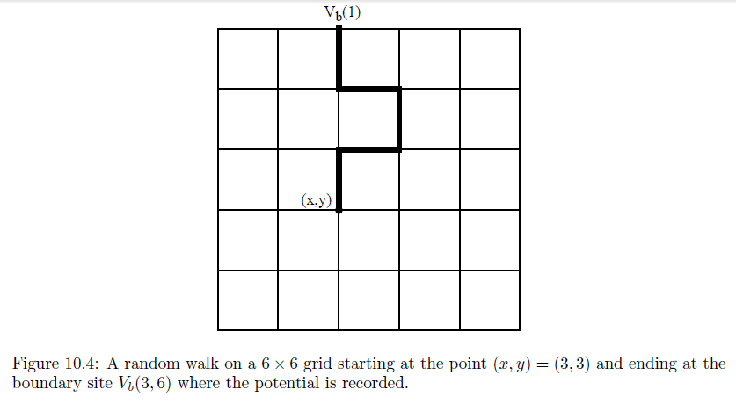

Slide 6
Advantages and disadvantages?

Slide 7
The disadvantage of the random walk method is that it requires many walkers to obtain a good estimate of the potential at each site.
However, if the potential is needed at only a small number of sites, then the random walk method might be more appropriate than the relaxation method which requires the potential to be computed at all points within the region.

Slide 8
Another case where the random walk method is appropriate is when the geometry of the boundary is fixed, but the potential in the interior for a variety of different boundary potentials is needed.
In this case the quantity of interest is G(x, y, xb, yb), the number of times that a walker from the point (x, y) lands at the boundary (xb, yb).
The random walk algorithm is equivalent to the relation
V (x, y) =1/nΣG(x, y, xb, yb)V (xb, yb), xb;yb

Slide 9
where the sum is over all sites on the boundary.
We can use the same function G for different distributions of the potential on a given boundary.
G is an example of a Green’s function, a function that you will encounter in advanced treatments of electrodynamics and quantum mechanics.
Of course, if we change the geometry of the boundary, we have to recompute the function G.

Slide 10
The random walk algorithm can help us gain additional insight into the nature of the solutions of Laplace’s equation.
Suppose that you have a boundary similar to the one shown in Figure next page.
The potentials on the left and right boundaries are V_{L} and V_{R}, respectively.
If the neck between the two sides is narrow, it is clear that a random walker starting on the left side has a low probability of reaching the other side.
Hence, we can conclude that the potential in the interior of the left side is approximately V_{L}, except very near the neck.

Slide 11
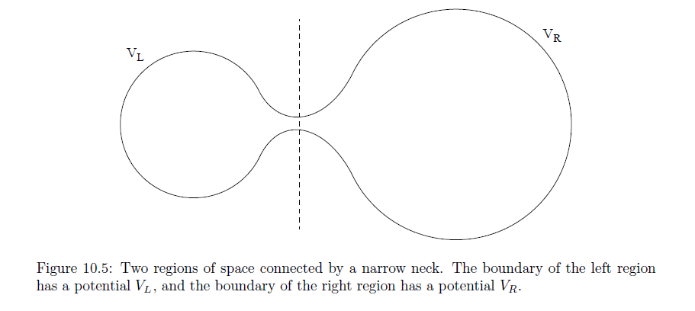

Slide 12
Poisson’s equation also can be solved using the random walk method. In this case, the potential is given by
V (x, y) =(1/n)ΣV (α) +(πΔxΔy/n)Σρ(x_{i; α}, y_{i; α}),
where α labels the walker, and i labels the site visited by the walker.
That is, each time a walker is at site i, we add the charge density at that site to the second sum in the above equation.

Slide 13
PHYS3061 Homework
Electrostatics and partial differential equations

Slide 14
Introduction
This homework prepares you for Lab 6
It contains three problems (all of them are theoretical calculations)
First: Solving 2D Laplace equation in Cartesian coordinates
Second: Analyze the dimension of 2D Poisson equation
Third: Derive the Gauss Law in 2D
In the lab, you will
Solve 2D Laplace and Poisson equation numerically, and compare with the theoretical results

Slide 15
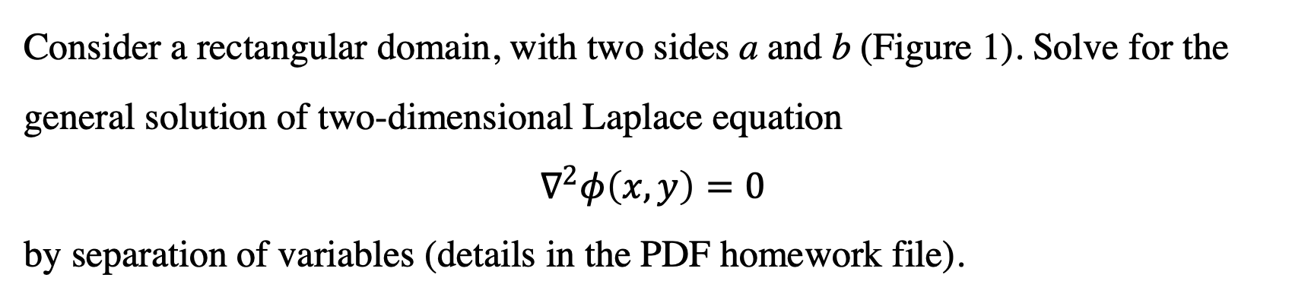
Problem 1 Solve the 2D Laplace equation
Consider a rectangular domain, with two sides a and b (Figure 1). Solve for the general solution of two-dimensional Laplace equation
$$∇^{2}φ\left(x,y\right)=0$$
by separation of variables (details in the PDF homework file).
y
b
x
a

Slide 16
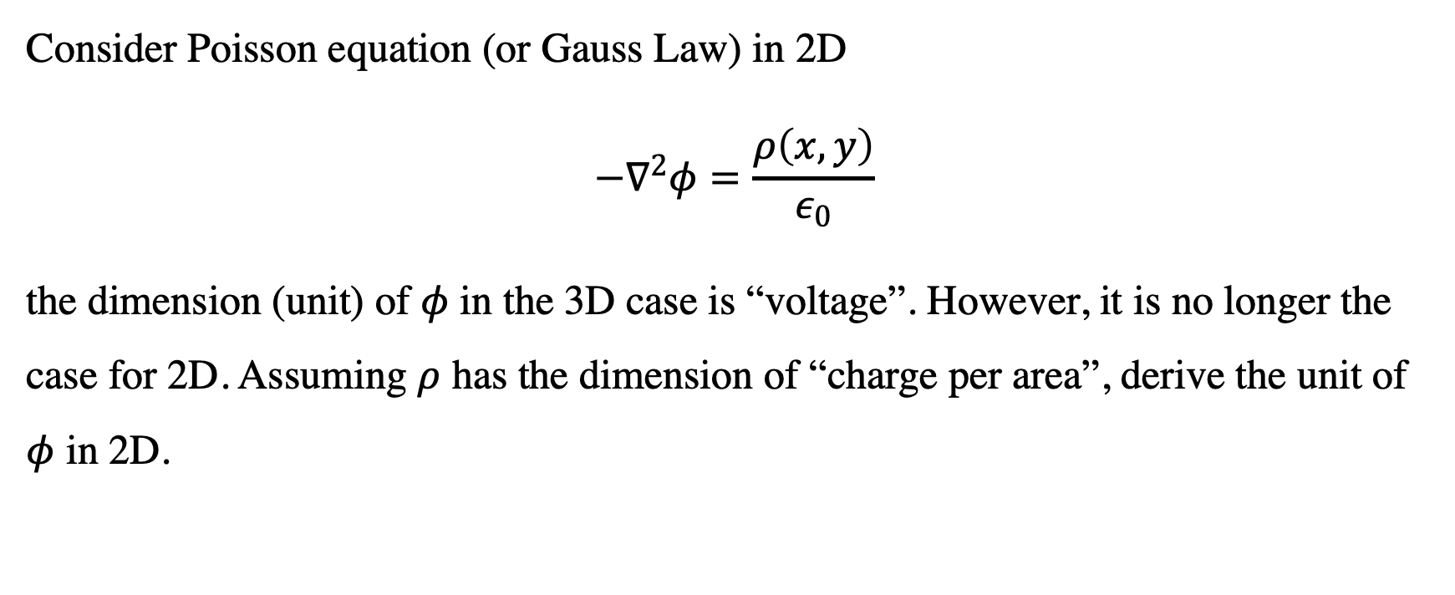
Problem 2 Dimensions in 2D Poisson equation
Consider Poisson equation (or Gauss Law) in 2D
$$−∇^{2}φ=\frac{ρ\left(x,y\right)}{ε_{0}}$$
the dimension (unit) of $φ$ in the 3D case is “voltage”. However, it is no longer the case for 2D. Assuming $ρ$ has the dimension of “charge per area”, derive the unit of $φ$ in 2D.

Slide 17
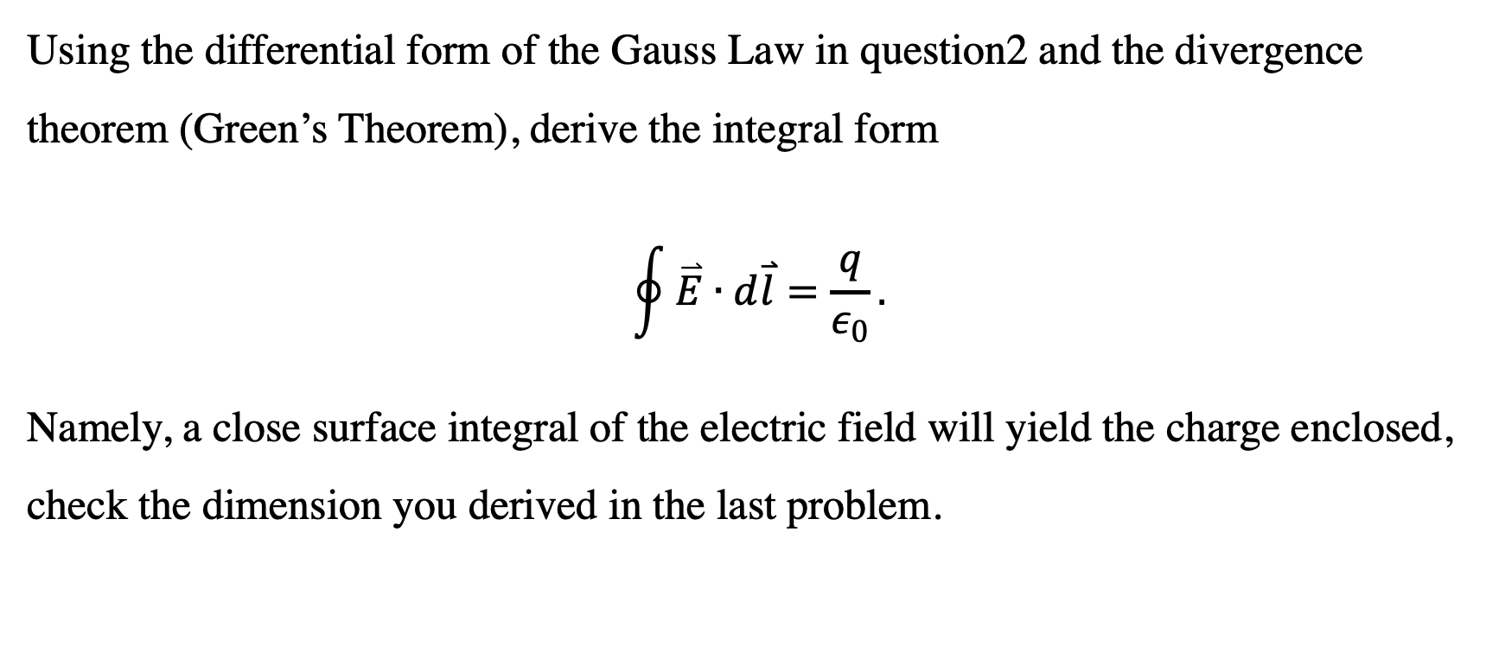
Problem 3 Gauss Law in 2D
Using the differential form of the Gauss Law in question2 and the divergence theorem (Green’s Theorem), derive the integral form
$$\oint{\overset{⃑}{E}∙d\overset{⃑}{l}}=\frac{q}{ε_{0}}.$$
Namely, a close surface integral of the electric field will yield the charge enclosed, check the dimension you derived in the last problem.

Slide 18
Simple classical and Monte Carlo methods
including importance sampling
illustrated in the context of the numerical evaluation of definite integrals.

Slide 19
Numerical Integration Methods in One Dimension
We can use sequences of random numbers to estimate definite integrals,
seemingly has nothing to do with randomness.
Several common classical methods
for numerically evaluating definite integrals.
Any suggestions on how to do such integrations with classical methods or with randomness?

Slide 20
These methods,
Although usually preferable in low dimensions,
impractical for multidimensional integrals
Monte Carlo methods: essential for the evaluation of the latter
if the number of dimensions is sufficiently high.
Why?

Slide 21
one-dimensional definite integral:
F =∫_{a}^{b} f(x) dx. (1)
For some f(x),
the integration can be done analytically,
Found in tables of integrals,
or evaluated as a series.
Or with the help of software like mathematica.

Slide 22
However, relatively few functions can be evaluated analytically
most functions must be integrated numerically.

Slide 23
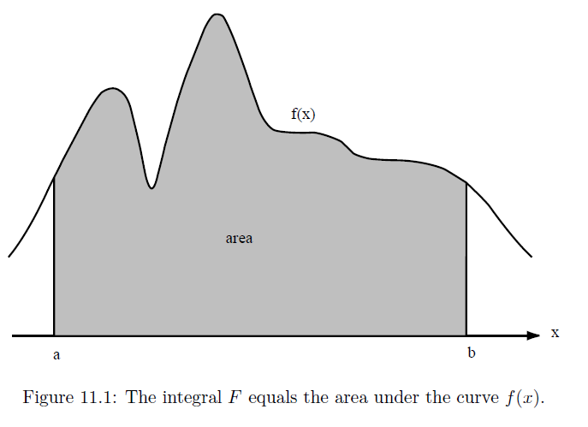
Most classical methods of numerical integration are based on the geometrical interpretation of the integral as the area under the curve of the function f(x) from x = a to x = b.

Slide 24
In these methods the x-axis is divided into n equal intervals of width Δx, where Δx is given by
Δx =(b − a)/n, (2a)
And x_{n} = x₀ + nΔx. (2b)
In the above, x₀ = a and x_{n} = b.

Slide 25
The simplest approximation of the area under the curve f(x): the sum of the area of the rectangles shown in Figure 2.
In the rectangular approximation, f(x) is evaluated at the beginning of the interval, and the approximate of the integral, Fn, is given by
F_{n} =Σf(xi)Δx. i = 0… n-1(3) (rectangular approximation.)

Slide 26
In the trapezoidal approximation the integral is approximated by a sum of trapezoids.
The area is computed by choosing one side equal to f(x) at the beginning of the interval and the other side equal to f(x) at the end of the interval.

Slide 27
This approximation is equivalent to replacing the function by a straight line connecting the values of f(x) at the beginning and the end of each interval.
Because the area of the trapezoid from xi to xi+1 is given by 1/2 [f(xi+1) + f(xi)]Δx,
The total area Fn of the trapezoids is given by
Fn =[1/2f(x0) +Σf(xi) +1/2f(xn)]Δx. i = 1 … n-1, (trapezoidal approximation) (4)
Any further improvements of accuracies?

Slide 28
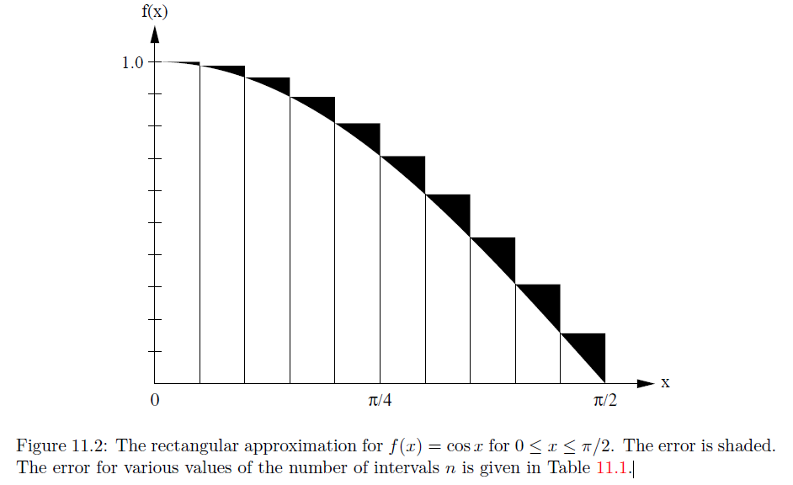

Slide 29
A generally more accurate method is to use a quadratic or parabolic interpolation procedure through adjacent triplets of points.
For example, the equation of the second-order polynomial that passes through the points (x0, y0), (x1, y1), and (x2, y2) can be written as
y(x) =(x − x1)(x − x2) y0 /[(x0 − x1)(x0 − x2)] +(x − x0)(x − x2)y1/[(x1 − x0)(x1 − x2)]+(x − x0)(x − x1)y2/[(x2 − x0)(x2 − x1)]. (5)

Slide 30
The area under the parabola y(x) between x0 and x2 can be found by integration and is given by
F₀ =1/3 (y0 + 4y1 + y2)Δx,
where Δx = x1−x0 = x2−x1.
The total area under all the parabolic segments yields the parabolic approximation for the total area:
Fn =1/3 [f(x0) + 4f(x1) + 2f(x2) + 4f(x3) + . . .+ 2f(xn−2) + 4f(xn−1) + f(xn)] Δx. (Simpson’s rule) (7)

Slide 31
This approximation is known as Simpson’s rule,
although a more descriptive name would be the parabolic approximation.
Note that Simpson’s rule requires that n be even.
Why?

Slide 32
To write a program of the rectangular approximation=>
we must define the function we wish to integrate.
Although we could define a new integration class for each function
or change the function in the class and recompile each time,
Convenient to input the name of the function as a string
then parse the string so that the function can be evaluated.

Slide 33
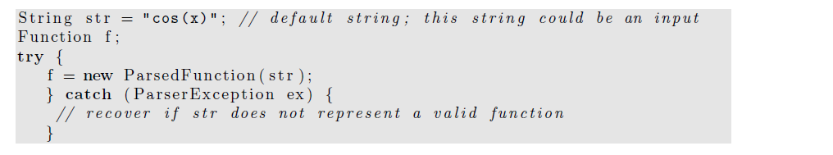
Because the Parsed Function often is used with keyboard input and it is common for users to mistype the name of a function,
the ParsedFunction constructor throws an exception that must be caught.

Slide 34
One way to display a function in a drawing panel:
to evaluate the function f(x) at various x values
and plot the (x, f(x)) data points.
Although we could do so using a loop
to add a predetermined number of points to a data set,
a better way is to use the FunctionDrawer class in the display package.

Slide 35
The FunctionDrawer evaluates a given function at every pixel location within a drawing panel
thereby producing a plot with optimum resolution.
// drawingPanel c r e a t e d p r e v i o u s l y
drawingPanel . addDrawable (new FunctionDrawer ( f ) ) ;

Slide 36
We next define the class RectangularApproximation
which computes the area under the curve using the rectangular approximation.
This class also displays the rectangles used to compute the area.
Note how we have extended the Dataset class to produce the visualization.

Slide 37
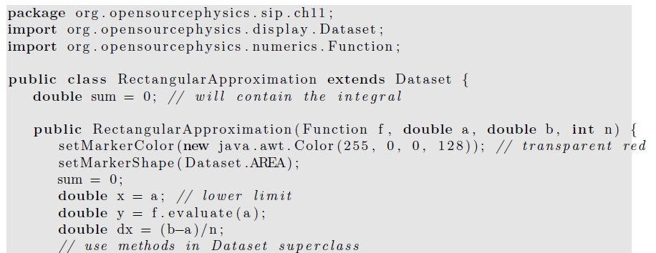

Slide 38
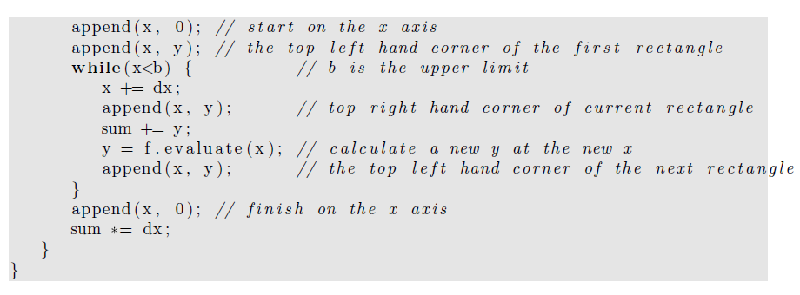

Slide 39
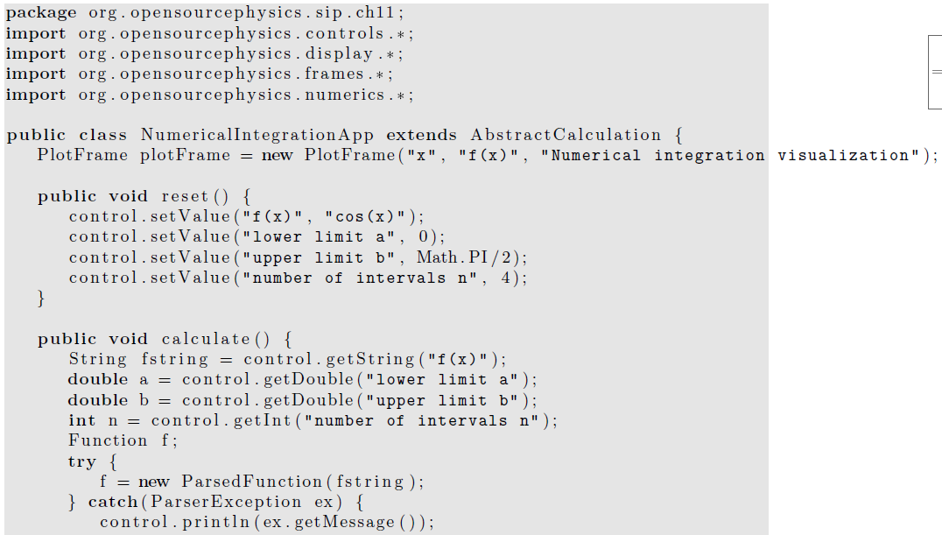
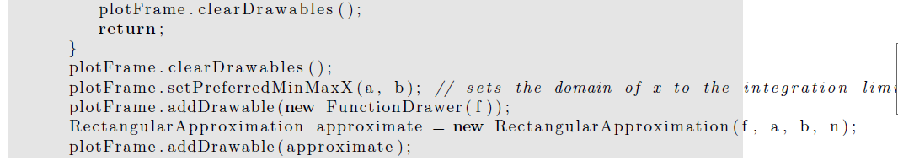

Slide 40
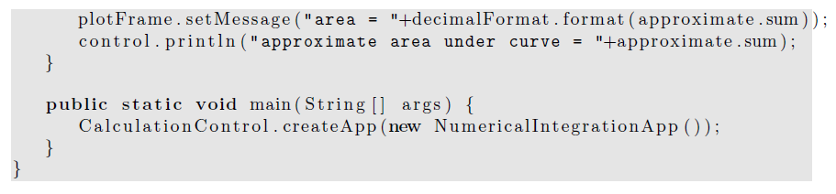

Slide 41
We consider the accuracy of the rectangular approximation for the integral of f(x) = cos x from x = 0 to x = π/2 by comparing the numerical results shown in Table 11.1
with the exact answer of unity.
Note that the error decreases as n⁻¹.
This observed n⁻¹ dependence of the error is consistent with the analytical derivation of the n dependence of the error.

Slide 42
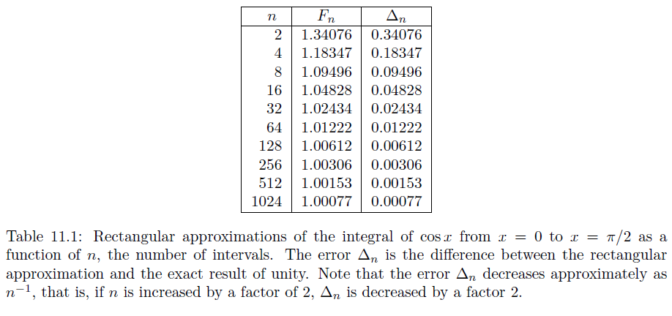

Slide 43
The rectangular and trapezoidal algorithms converge relatively slowly
and are therefore not recommended in general.
In practice, Simpson’s rule is adequate for functions that are reasonably well behaved,
that is, functions that can be adequately represented by a polynomial.
How do we decide whether the our choices of n is large enough to provide accurate results?

Slide 44
If f(x) is such a function,
we can adopt the strategy of evaluating the area for a given number of intervals n and
then doubling the number of intervals and evaluating the area again.
If the two evaluations are sufficiently close to one another, we stop.
Otherwise, we again double n until we achieve the desired accuracy.

Slide 45
this strategy will fail if f(x) is not well behaved.
An example of a poorly behaved function is f(x) = x^{−1/3} at x = 0,
where f(x) diverges.
Another example where this strategy might fail is when a limit of integration is equal to ±∞.
How do we handle this type of problems?

Slide 46
In many cases we can eliminate the problem by a change of variables.

Slide 47
Because integration is usually a routine task,
the integration methods discussed in this section are implemented in the Integral class in the numerical package.
Method Integral.ode computes the integrals using an ODE solver
as discussed in the following.
The solver uses an adaptive step size to achieve the desired tolerance.

Slide 48
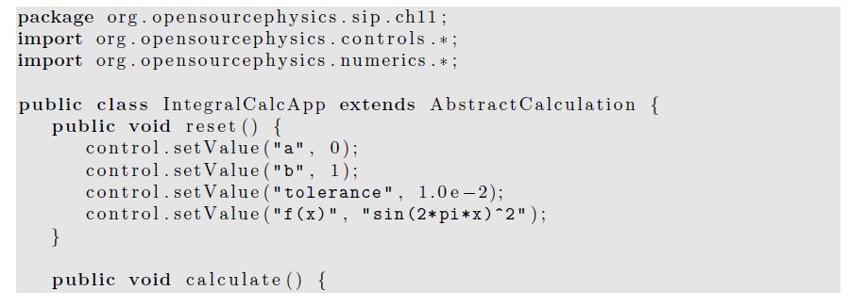

Slide 49
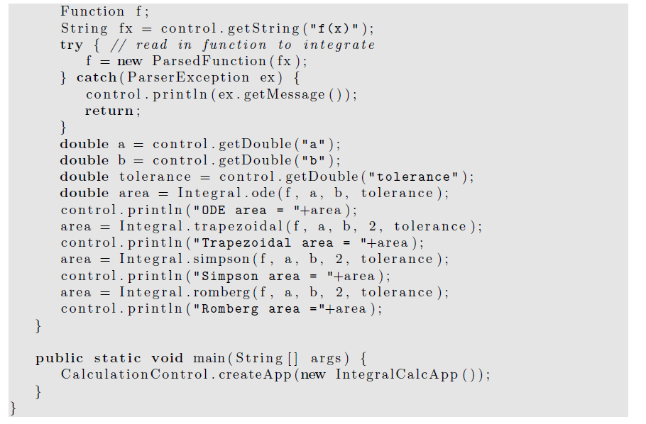

Slide 50
The algorithms in the Integral class are implemented using static methods
so that they are easy to invoke.
These methods accept a tolerance parameter that allows the user to specify the acceptable relative precision.
Because computers store floating point numbers using a fixed number of decimal places,
we use relative precision to determine the accuracy of the integration method.

Slide 51
However, relative precision is meaningful
only if the result is different from zero.
If the result is zero, the only possible check is for absolute precision.

Slide 52
Another way of evaluating one-dimensional integrals is to recast them as differential equations.
Consider an indefinite integral of the form
F(x) =∫^{x}_{a}f(t) dt, (9)
where F(a) = 0.
If we differentiate F(x) with respect to x, we obtain the first-order differential equation:
dF(x)/dx= f(x). (10) with the boundary condition F(a) = 0.

Slide 53
Because the function f(x) is known, (10) can be solved for F(x) using the numerical algorithms
that we introduced earlier
for obtaining the numerical solutions of first-order differential equations.

Slide 54
In general, the methods for solving ordinary differential equations and evaluating numerical integrals are not equivalent.
For example, we cannot use Simpson’s rule to obtain the numerical solution of an differential equation of the form dy/dx = f(x, y).

Slide 55
Simpson’s rule fails (or is slowly convergent)
if the function has regions of rapid change.
In this case, an adaptive step-size ODE algorithm is usually effective.
The RK45MultiStep solver adapts the integration step to the behavior of the integrand and allows the user to set the tolerance.

Slide 56
As computers become more powerful
and software to perform mathematical operations and numerical analysis becomes more prevalent,
there is a strong temptation to use libraries by others.
This use is appropriate because usually these libraries are well written,

Slide 57
and there is no reason why a user should re-invent them.
However, the downside is that users do not always know or care what the libraries are doing and sometimes can obtain puzzling or even incorrect results.

Slide 58
Simple Monte Carlo Evaluation of Integrals
We now explore a much different method of estimating integrals.
Consider the following example.
Suppose an irregularly shaped pond is in a field of known area A.
The area of the pond can be estimated by throwing stones so that they land at random within the boundary of the field
And counting the number of splashes
that occur when a stone lands in a pond.

Slide 59
The area of the pond is approximately the area of the field times the fraction of stones that make a splash.
This simple procedure is an example of a Monte Carlo method.

Slide 60
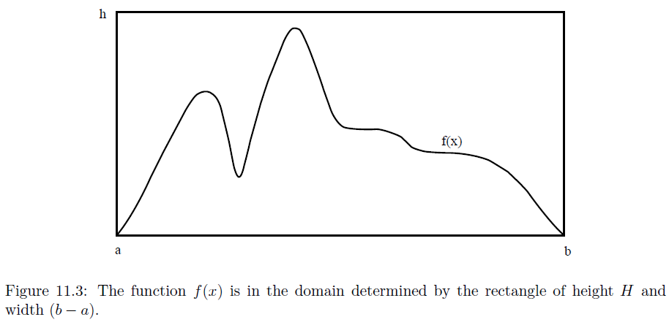
To be more specific, imagine a rectangle of height h, width b − a, and area A = h(b − a)
Such that the function f(x) is within the boundaries of the rectangle .
Compute n pairs of random numbers xi and yi with a ≤ xi ≤ b and 0 ≤ yi ≤ h.

Slide 61
The fraction of points xi, yi that satisfy the condition yi ≤ f(xi) is an estimate of the ratio of the integral of f(x) to the area of the rectangle.
Hence, the estimate F_{n} in the hit or miss method is given by F_{n} = An_{s}/n, (hit or miss method) (13)
where ns is the number of points below the curve or “splashes,”
and n is the total number of points.
Any other methods to apply random processes to compute integrations?

Slide 62
The number of points chosen at random in (13) should not be confused with the number of intervals used in the numerical methods discussed in Section 1.
Another Monte Carlo integration method is based on a mean-value theorem of integral calculus,
which states that the definite integral (11.1) is determined by the average value of the integrand
f(x) in the range a ≤ x ≤ b: F =∫_{a}^{b} f(x)dx = (b − a)⟨f⟩. (14)

Slide 63
To determine ⟨f⟩, we choose the x_{i} at random instead of at regular intervals and sample the values of f(x).
For the one-dimensional integral,
the estimate Fn of the integral in the sample mean method is given by Fn = (b − a) 1/n Σf(xi) ≈ (b − a)⟨f⟩. i=1…n, (sample mean method) (15)

Slide 64
The xi are random numbers distributed uniformly in the interval a ≤ xi ≤ b, and n is the number of samples.
Note that the forms of (3) and (15) are formally identical except that the n points are chosen with equal spacing in (3) and with random spacing in (15).
We will find that for low dimensional integrals (3) is more accurate, but for higher dimensional integrals (15) does better.

Slide 65
A simple program that implements the hit or miss method is given in Listing 4.
Note the use of the Random class and the methods setSeed and nextDouble().
The primary reason that it is desirable to specify the seed
rather than to choose it more or less at random from the time (as is done by Math.random())
is that it is convenient to use the same random number sequence when testing a Monte Carlo program.

Slide 66
Suppose that your program gives a strange result for a particular run.
If we find an error in the program, we can use the same random number sequence
to test whether our program changes make any difference.
Another reason for specifying the seed is
so that other users can reproduce your results.

Slide 67
Listing 11.4: MonteCarloEstimatorApp displays the estimate of the integral for the number of samples equal to 2p.
package org.opensourcephysics.sip.ch11;

Slide 68
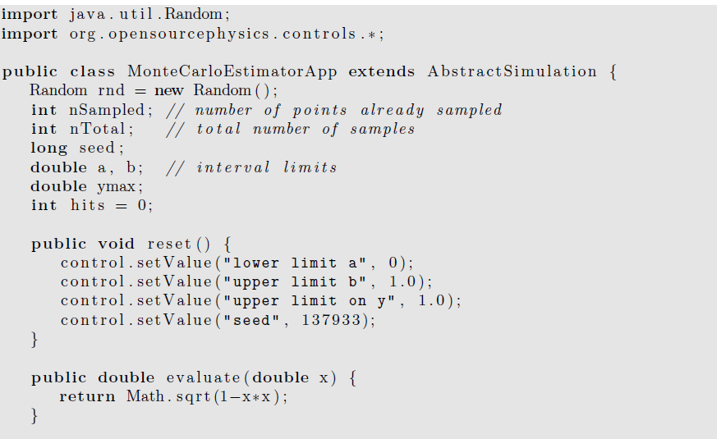

Slide 69
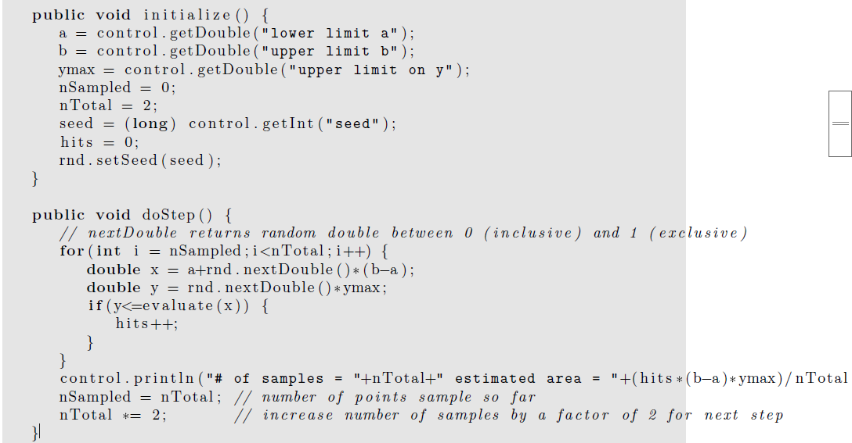

Slide 70
public static void main ( String [ ] args ) {
SimulationControl.createApp (new MonteCarloEstimatorApp ( ) ) ;
}
}

Slide 71
Multidimensional Integrals
Many problems in physics involve averaging over many variables.
For example, suppose we know the position and velocity dependence of the total energy of ten interacting particles.
In three dimensions,
each particle has three velocity components
and three position components.

Slide 72
Hence the total energy is a function of 60 variables,
and a calculation of the average energy per particle involves computing a d = 60 dimensional integral.
More accurately, the total energy is a function of 60 − 6 = 54 variables
if we use center of mass and relative coordinates.

Slide 73
If we divide each coordinate into p intervals, there would be p⁶⁰ points to sum.
Clearly, standard numerical methods such as Simpson’s rule would be impractical for this example.

Slide 74
A discussion of the n dependence of the error associated with the standard numerical methods for d-dimensional integrals is given in Appendix 11A. (We’ll cover it in the next lecture.)
We show that if the error decreases as n^{−a} for d = 1,
then the error decreases as n^{−a/d} in d dimensions.
In contrast, we find that the error for all Monte Carlo integration methods decreases as n^{−1/2} independently of the dimension of the integral.

Slide 75
Because the computational time is roughly proportional to n in both the classical and Monte Carlo methods,
we conclude that for low dimensions, the classical numerical methods
such as Simpson’s rule are preferable to Monte Carlo methods
unless the domain of integration is very complicated.
However, Monte Carlo methods are essential for higher dimensional integrals.

Slide 76
To illustrate the evaluation of multidimensional integrals, we consider the two-dimensional
Integral F = ∫_{R}f(x, y) dxdy, (16)
where R denotes the region of integration.

Slide 77
The extension to higher dimensions is straightforward,
but tedious.
A simple illustration:
Form a rectangle that encloses the region R,
and divide this rectangle into squares of length h.
Assume that the rectangle runs from xa to xb in the x direction and from ya to yb in the y direction.

Slide 78
The total number of squares is n_{x}n_{y}, where n_{x} = (x_{b} − x_{a})/h and n_{y} = (y_{b} − y_{a})/h.
If we use the midpoint approximation, the integral F is estimated by
F ≈ΣΣ f(x_{i}, y_{j})H(x_{i}, y_{j}) h², i = 1… nx, j= 1… ny.
where x_{i} = x_{a} + (i − 1/2 )h,
y_{j} = y_{a} + (j − 1/2 )h, and the (Heaviside) function H(x, y) = 1 if (x, y) is in R and equals 0 otherwise.

Slide 79
A simple Monte Carlo method for evaluating a two-dimensional integral uses the same rectangular region,
but the n points (xi, yi) are chosen at random within the rectangle.
The estimate for the integral is then
Fn =A/nΣ f(xi, yi)H(xi, yi), i = 1 … n(18)
where A is the area of the rectangle.

Slide 80
Note that if f(x, y) = 1 everywhere, then (18) is equivalent to the hit or miss method of calculating the area of the region R.
In general, (18) represents the area of the region R multiplied by the average value of f(x, y) in R.

